Slide 1
Active Seniors in Helsinki and Central Europe
„Ageing and Public Spaces”
25 of September Prague
József Veress

Slide 2
TOPICS
Active Seniors' Community – “become the subject of our life”
CedarNet – senior citizens as social asset

Slide 3
Lopukkiri – self-organizing mutual care in helsinki
.

Slide 4
Active Seniors
Finnish Association simultaneous
  construction of a 9 floors building in a new district of Helsinki
  systematic community-building
Co-create enabling care-friendly environment facilitating
  healthy and active ageing in a large city
  self-organizing mutual care giving
  Propose a new mode for Finland - the second most quickly aging developed society (after Japan)

Slide 5
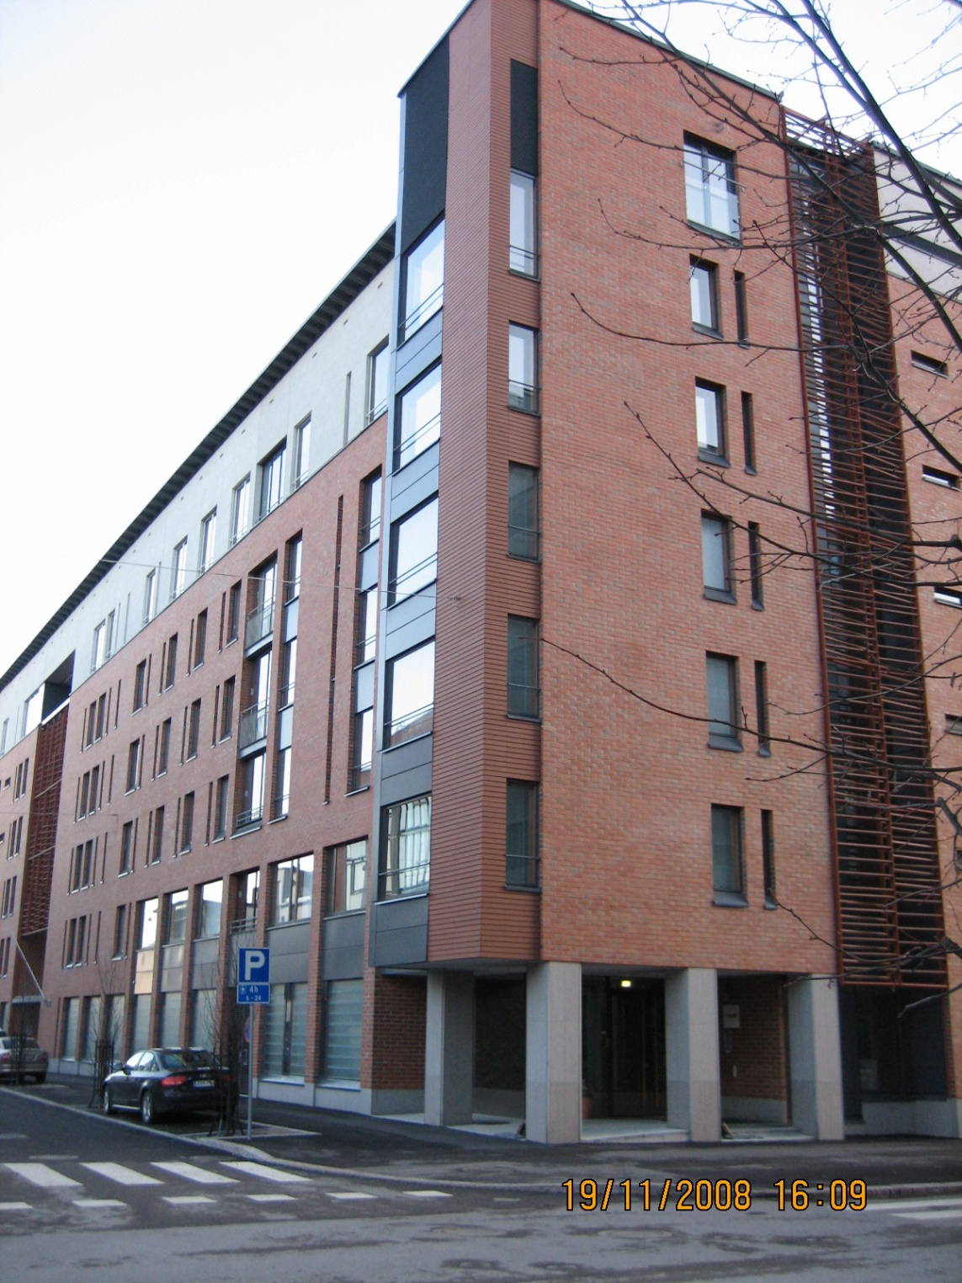
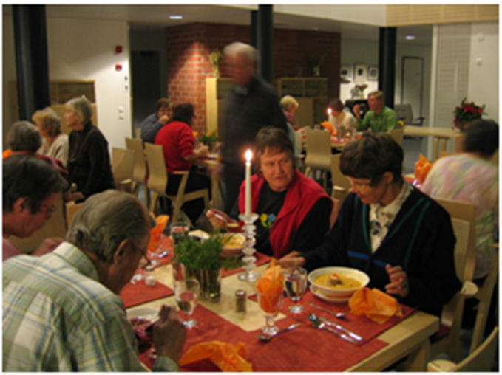

Slide 6
Focus
Ensure meaningful and dignified elderly life
Offer an alternative model of self-organzing mutual care-taking
Prevent to beome ‘users of care-taking services’ passive and often un-dignified objects

Slide 7
CONCEPT
“Loppukiri is the first senior house in Finland where every inhabitant belongs to a working group and has the feeling of being important to the community. Because there are no employed staffs we really work for the benefit of the community, instead of busying ourselves with unnecessary little things. This leads to empowerment and activation of the individuals and they start to make independent initiative”(100-20-28-5:5)

Slide 8
Active, meaningful, and dignified elderly life
“Hopefully the Loppukiri-project shows that ageing people are a significant resource in the society. We do not want to be only involuntary objects of decision-making but actors in our own life, subjects also as senior citizens”
(100-20-28-5:4)

Slide 9
Motives
“The objective of the Loppukiri project was to develop for seniors an alternative model of life, which would be based on cooperation and sense of community. The project started with brainstorming by private persons who wanted to take full charge of their lives also in the old age. The Finnish social security system was in crisis and a small group of women decided to find a good solution and started to plan actively the way they want to grow old. They established the Active Seniors’ Association which started to plan and design a housing community for senior citizens…”

Slide 10
Steps
„…find a site to build, then to create a model of communal living. They also had to find inhabitants who were willing to share the common premises and to work together for the community. And last but not least they had to find an architect and a constructor in order to build a block of flats for themselves, and to market their unique idea to the future inhabitants. That was quite a new way to act in Finland, but the dream came true. Our ageing group of people with a strong female majority built a house and created a well-functioning community”(100-20-27-8:6)

Slide 11
Tackling challenges
“Problems of financing the project and of recruiting inhabitants to the house arose repeatedly. …Brainstorming and creative thinking served as the resource in our difficulties and these ways of solving problems have rooted to be our general way of action even now when we are living in Loppukiri. ..These methods are valuable resources also at present and are often applied to solve the problems of our community”(100-20-27-8:3-4)

Slide 12
“To become the subjects of their lives”
The Active Seniors established work groups in frame of their new project coined as Loppukiri the “last sprint” to elaborate solutions for inevitable challenges that passing years and potential healthcare problems may create.
The ageing related politics are deeply emancipatory
  important to overcome austerity obsession

Slide 13
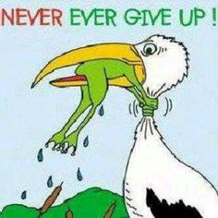
Conclusion

Slide 14
CEDARNET CONCEPT – SENIOR CITIZENS AS SOCIAL ASSET
.

Slide 15
Context
Our society –and cities – are mostly un-prepared for fulfil needs and mobilize capacities of an aging population
Tension between generations, lack of cooperation, discontentment
Poor senior health indicators, overloaded healthcare and social system

Slide 16
Aging and elderly people – perceived as growing social liability not as asset
The problem of ageing at the labor market:
  stress and work place prejudices
  burning out
  losing speed
Our societies are un-prepared to consider and even less to mobilize knowledge and capabilities of Senior Citizens
  serious waste of significant – potential - resources

Slide 17
CedarNet
  A new concept
    developed by Erika Sárközy and experts of Erasmus Institute Budapest
    based on international research and experiences, primarily customized to Eastern and Central European societies
  It aims to
  create network(s) faciltating ecosystems keeping people involved in economic life
  utilize senior experiences
  „outsource senior knowledge assets”

Slide 18
Eco-system - to handle ageing
CedarNet: a social innovation – a model for establishing the ecosystem of social ageing
Targeted ecosystem: new organizational frameworks and operating mechanisms, new forms of market cooperation, institutional connections, etc.

Slide 19
Threats – and Connections
Threats – and Connections
Knowledge gaps and recurring disadvantages
Poverty
- Losing jobs and tasks
- Health problems
- Financial difficulties
- Loss of competence
- Isolation
- Lack of plans for the
future
- Loss of dignity
- Pressure to adapt
Declining population
Threats in the social care system, GERIATRIC CARE
Rapidly growing rate of ageing and elderly population (24-30%)
Dementia, Alzheimer’s disease, epidemics
Poor health indicators
Generational conflicts
Labor shortage and unemployment
Depopulation of villages

Slide 20
Main Pillars of the CedarNet Concept
Senior experience = mostly unused human resource
To activate, cultivate and redevelop the capital of senior experience:
  To prepare society for the change of trends
  To enable lifelong work as meaningful value creation
    Focus on use and social value
Mainstreaming senior knowledge management is a crucial factor

Slide 21
The CEDARnet
  Prepares a pilot project in Hungary
  Plans a workshop with experts, stakeholders and interested parties, participants from the Visegrad countries to
    present the program,
    exchange experience, information on best practices and
    discuss necessary steps to contribute to a paradigm shift

Slide 22
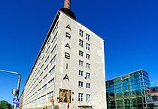
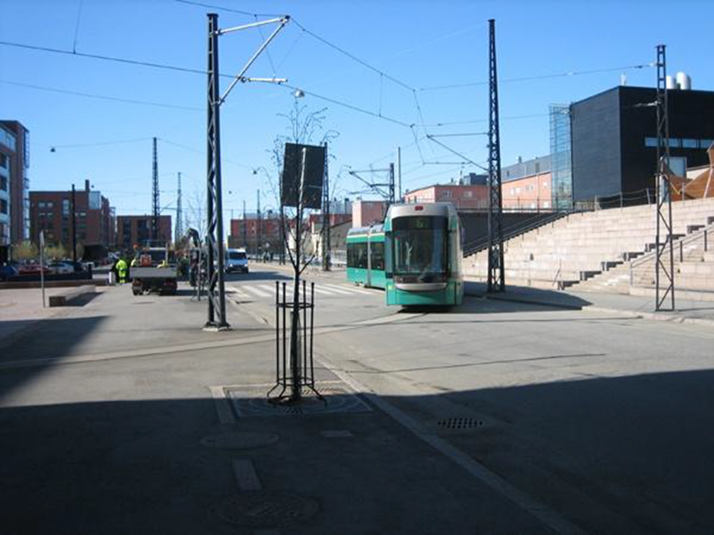
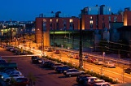
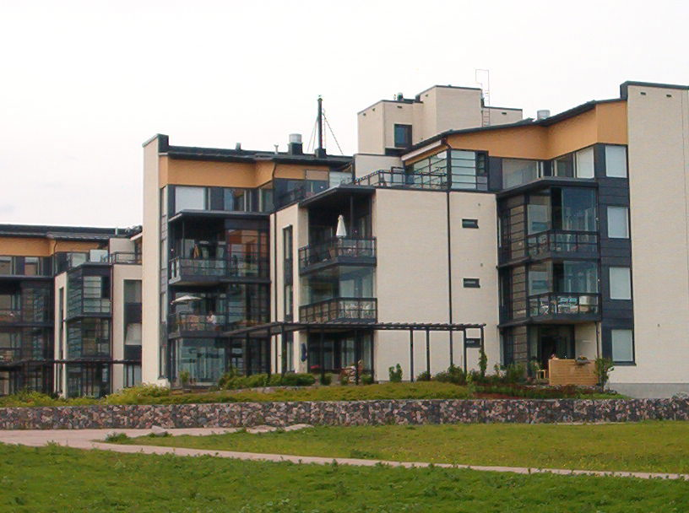
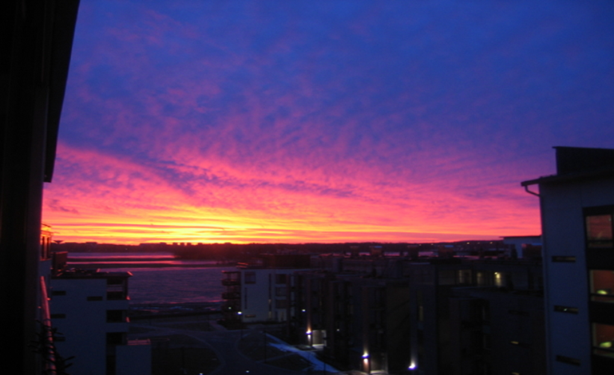
ARABIANRANTA

Slide 23
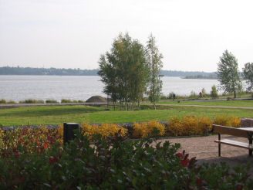

Slide 24

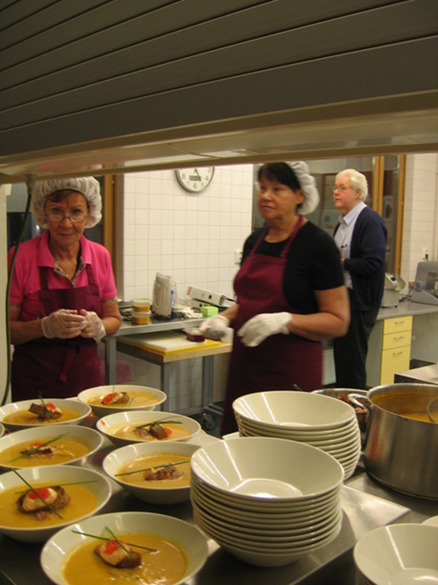

Slide 26
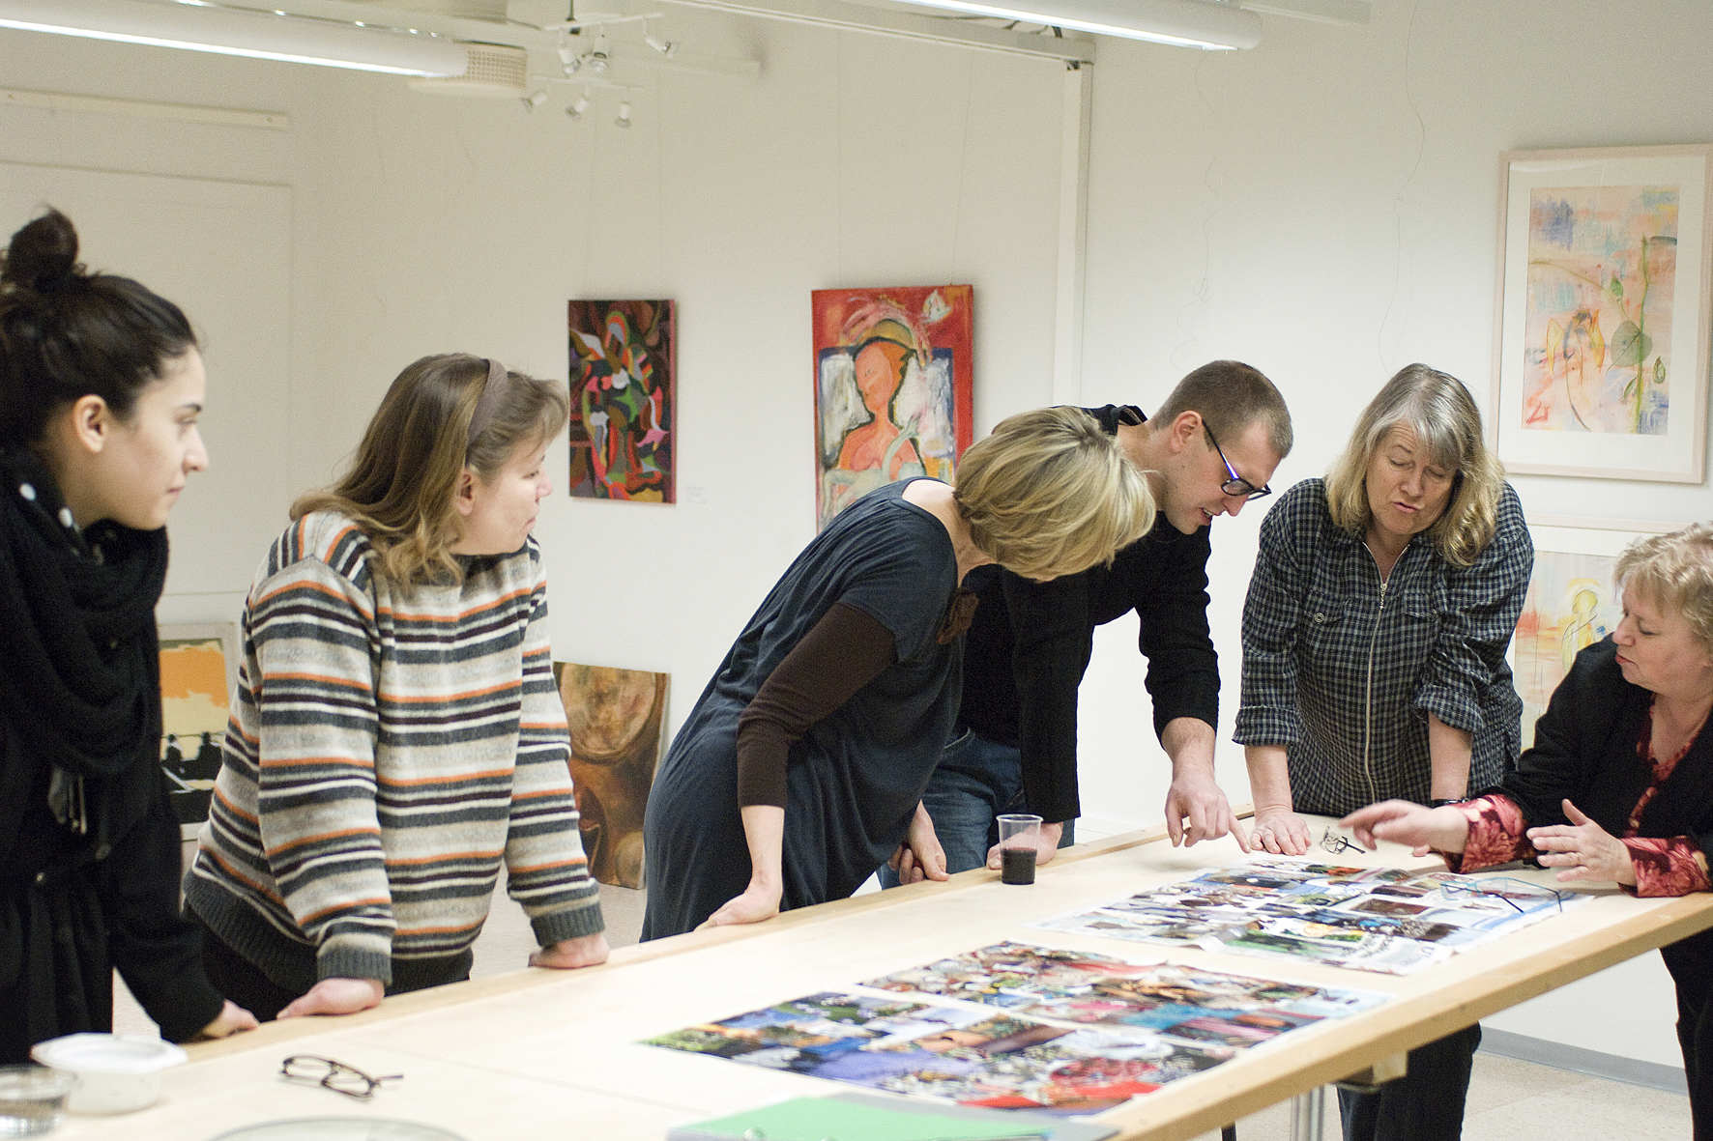

Slide 27
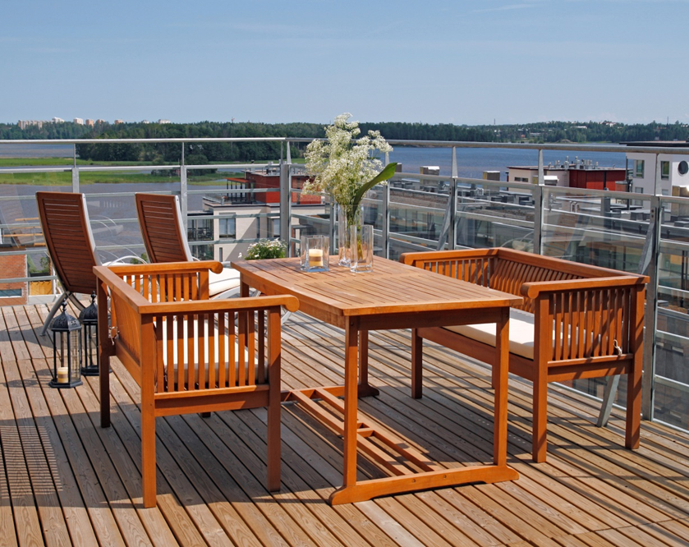
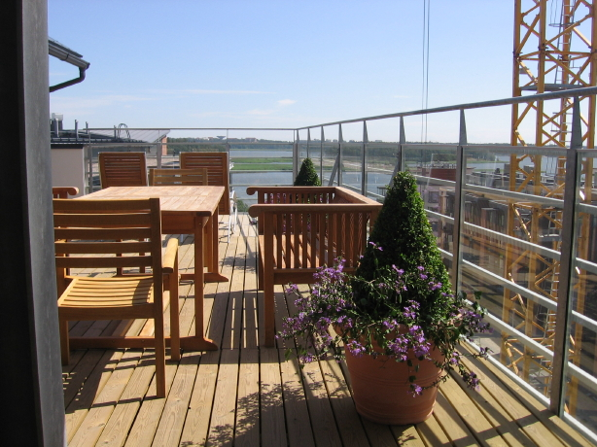
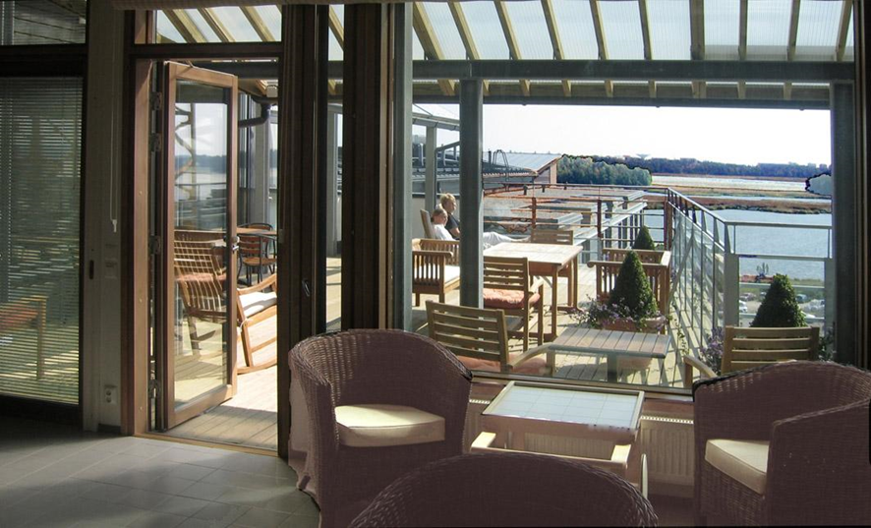

Slide 28
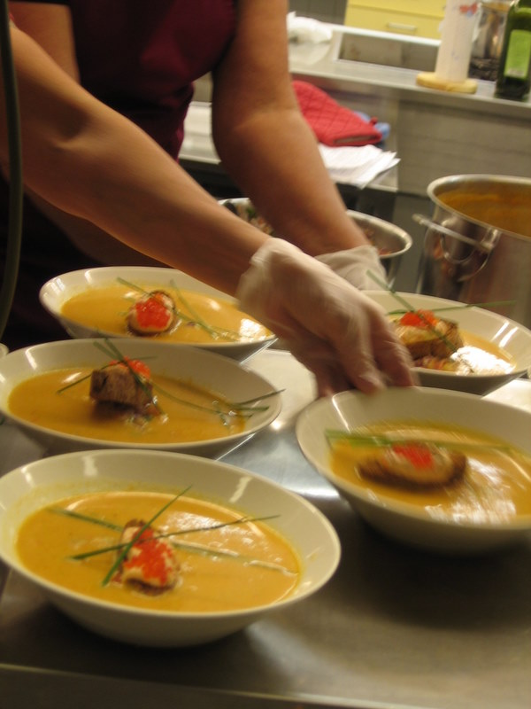
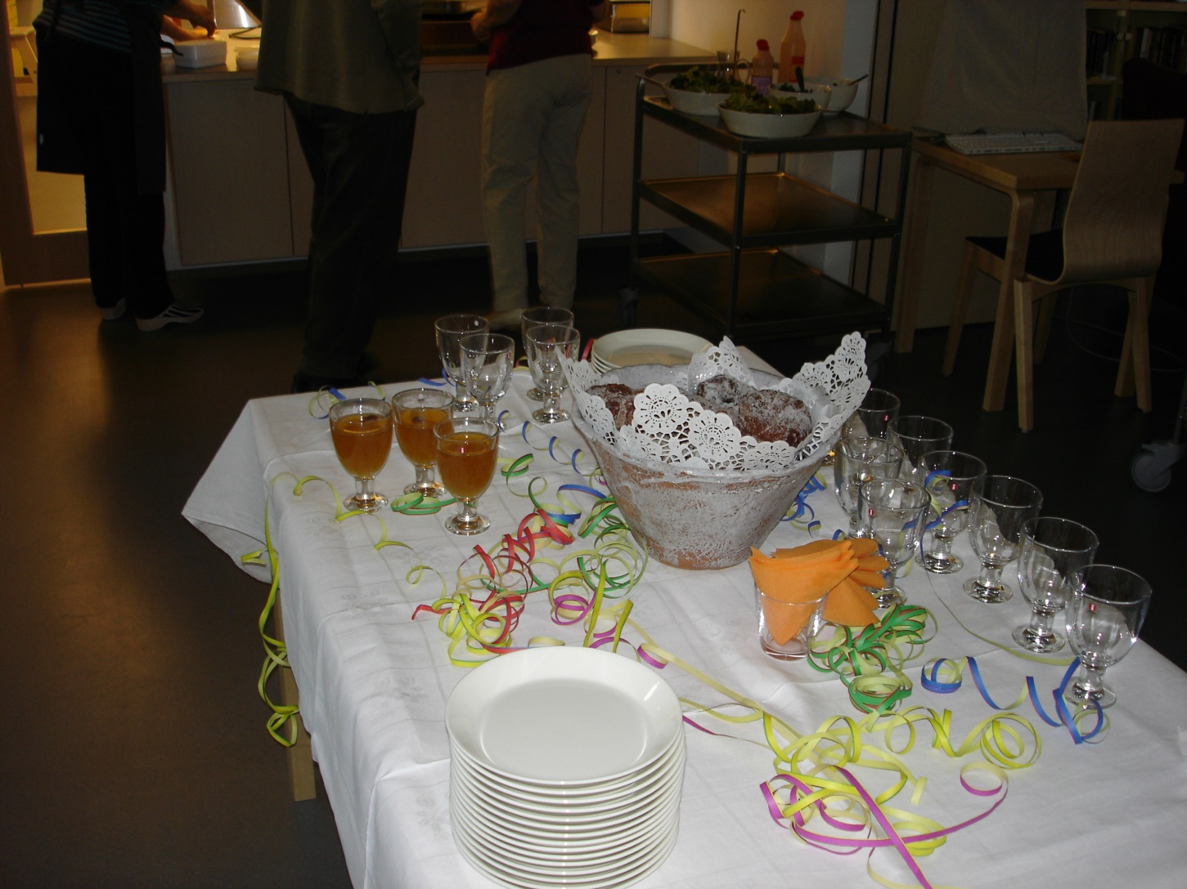

Slide 29
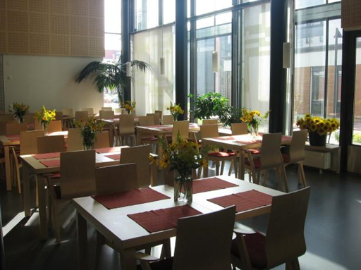
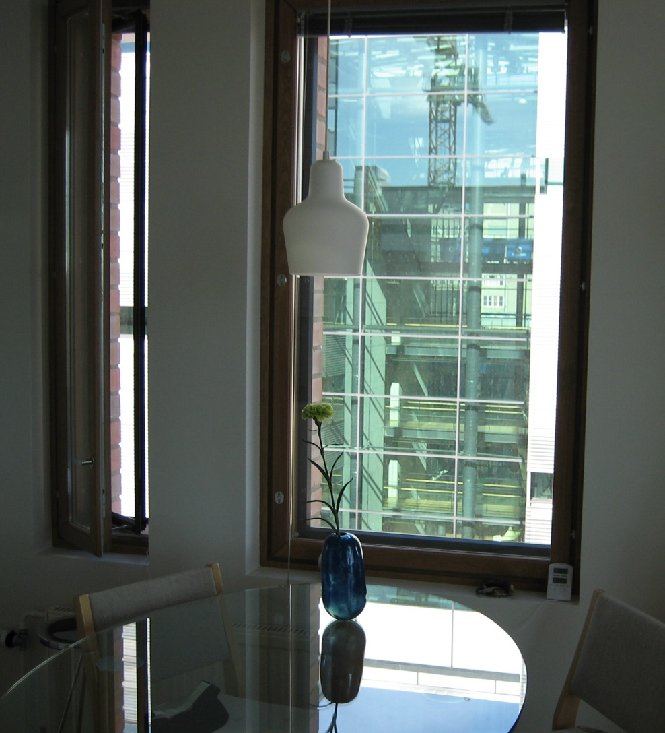
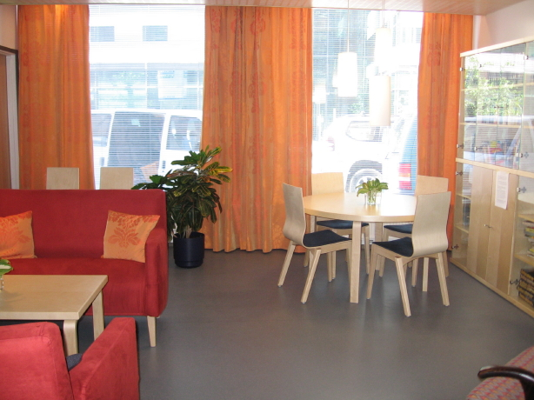

Slide 30

